Slide 1
Recent Advances in Augmented Reality
By R. Azuma, Y. Bailot, R. Behringer, S. Feiner, S. Julier, and B. MacIntyre
Presented by Eric Lam and Kathy Tang

Slide 2
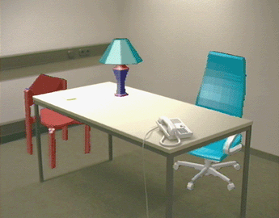
What is Augmented Reality?
A system which…
Combines real & virtual objects in real environment
Runs interactively in real time
Registers (aligns) real and virtual objects with each other

Slide 3
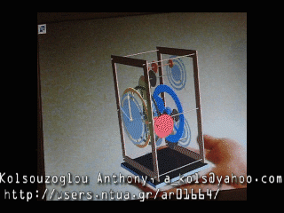
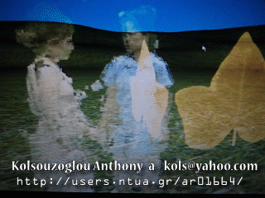
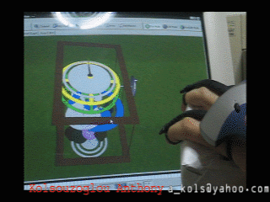
Milgram’s reality-virtuality continuum
a completely physical space which has no virtual elements
an Augmented Reality space is a physical space where virtual elements have been integrated
an Augmented Virtuality space is a virtual space where physical elements have been integrated
a completely virtual space which has no physical elements

Slide 4
Overview
Enabling technologies
Interfaces and visualization
Visualization problems
New applications
Future work

Slide 5
Enabling Technologies
Displays
Head-worn displays (HWD)
Handheld displays
Projection displays
Problem areas
New tracking sensors and approaches

Slide 6
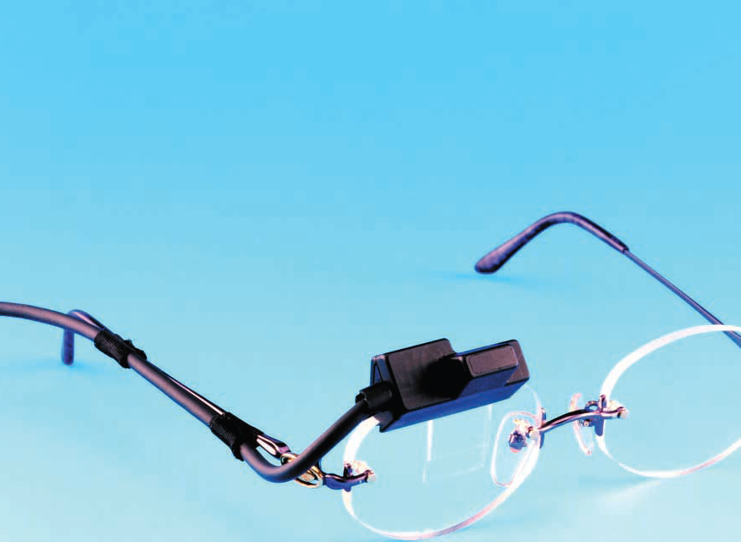
Enabling Technologies
Displays – head worn displays
Types of HWD:
Optical see-through
Video see-through
Retinal Display

Slide 7
Enabling Technologies
Displays – head worn displays
Characteristics:
No larger than pair of sunglasses
Lightweight
Minolta eyeglass display

Slide 8
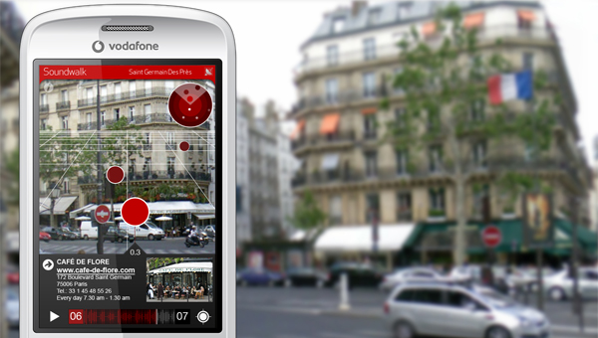
Enabling Technologies
Displays – handheld displays
Handheld, flat panel LCD Displays
Camera provides video see-through

Slide 9
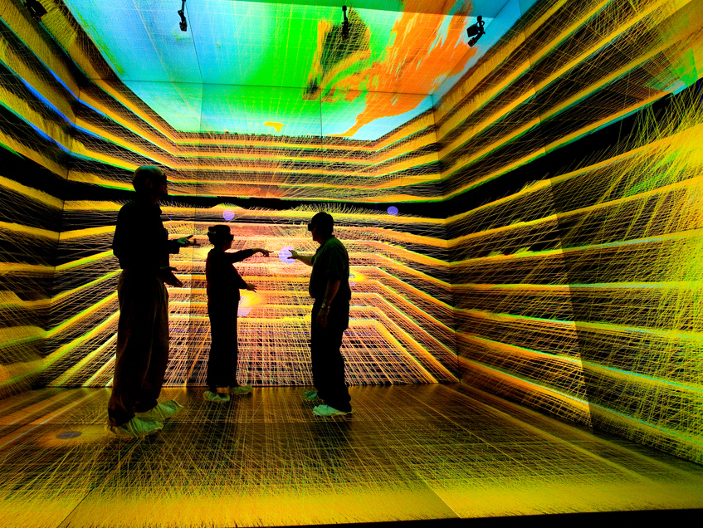
Enabling Technologies
Displays – projection displays
Project directly on physical object to be augmented
Objects coplanar with projection surface
Do not need special eyewear

Slide 10
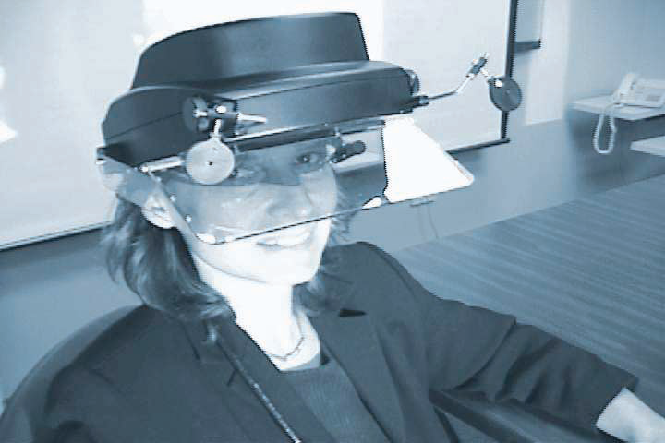
Enabling Technologies
Displays – projection displays
Headworn projection displays
Images projected at user’s line of sight
Retroreflective material
Coat target object
Reflects light back at angle of incidence
Different users see different projected images

Slide 11
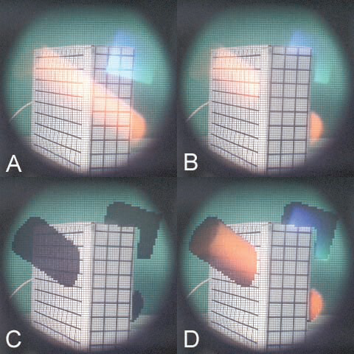
Enabling Technologies
Displays – problems
Insufficient brightness, resolution, field of view (see-through displays)
Virtual objects can’t completely occlude real ones
Display system alignment for eye
a) Transparent overlay, b) Transparent overlay w/ real world depth, c) LCD panel blocks areas to be occluded, d) opaque overlay blocking selected pixels

Slide 12
Enabling Technologies
Displays
New tracking sensors and approaches
Environment sensing
Outdoor, unprepared environments

Slide 13
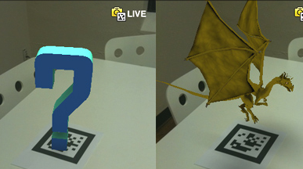
Enabling Technologies
New tracking sensors and approaches
Environment sensing
Effective AR needs: 1) user’s position & orientation, 2) position of objects, 3) depth map
Video tracking
Place markers in environment
Hybrid systems (video + magnetic sensors, video + accelerometer) have better performance

Slide 14
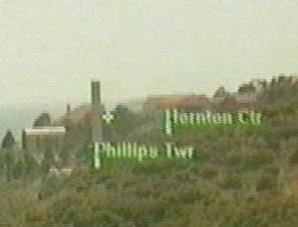
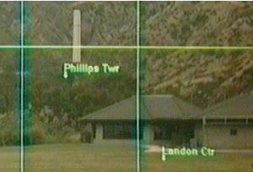
Enabling Technologies
New tracking sensors and approaches
Outdoor, unprepared environments
Outdoor & mobile AR apps
Not practical to cover environment with markers
Compass/gyroscope tracker (orientation)
GPS (position)
Unprepared environments
Rely on tracking visible natural features
Track horizon silhouette (given database of environment)

Slide 15
Overview
Enabling technologies
Interfaces and visualization
Visualization problems
New applications
Future work

Slide 16
Interfaces and Visualization
Utilizing Heterogeneous devices
Leverage advantage of different displays
Multiple interaction techniques

Slide 17
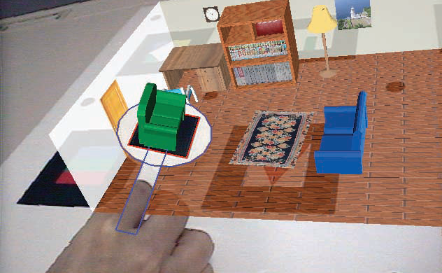
Interfaces and Visualization
Integrate virtual & physical through tangible interfaces

Slide 18
Overview
Enabling technologies
Interfaces and visualization
Visualization problems
New applications
Future work

Slide 19
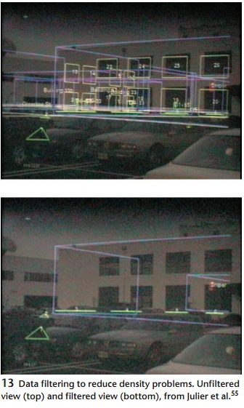
Visualization Problems
Errors and data density
Measured location may not be accurate
May cause visible registration error
Environment may be cluttered with information and become unreadable
Use filtering technique to remove clutter

Slide 20
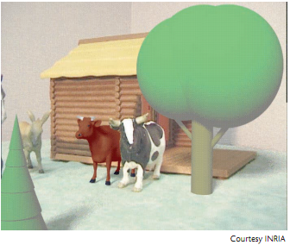
Visualization Problems
Advanced rendering
Mediated reality
Adding and removing objects
Photorealistic rendering
Real time rendering
Capture environmentally illumination and reflectance

Slide 21
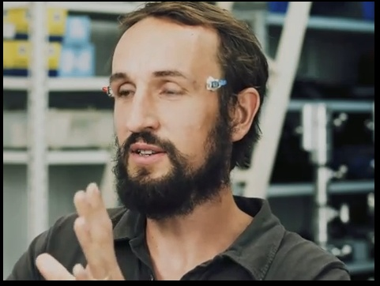
Visualization Problems
Perceptual and human factors
Latency
Depth perception
Adaptation
Fatigue and eye strain

Slide 22
Overview
Enabling technologies
Interfaces and visualization
Visualization problems
New applications
Future work

Slide 23
New Applications
Mobile
Navigation
Situational awareness
Geolocated information
Collaborative
Commercial

Slide 24
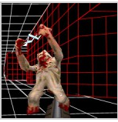
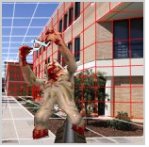
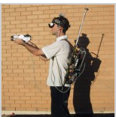
New Applications - Mobile
Touring Machine – Columbia University
Compass, GPS, inclinometer
Battlefield Augmented Reality System
ARQuake

Slide 25
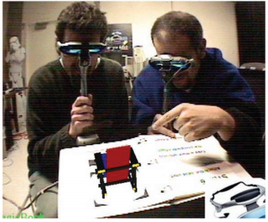
New Applications - Collaborative
Goals
Seamless integration with existing tools and practices
Enhance practice by supporting remote and collocated activities that would otherwise be impossible

Slide 26
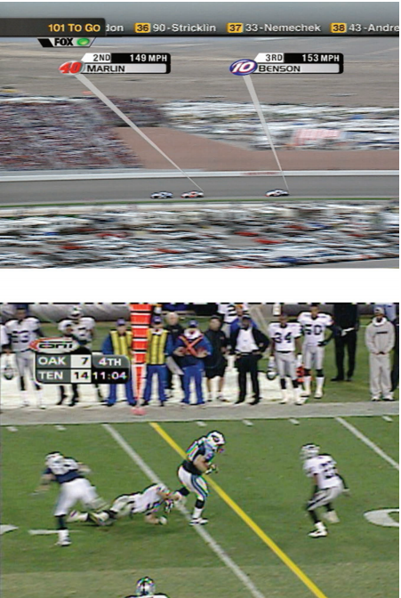
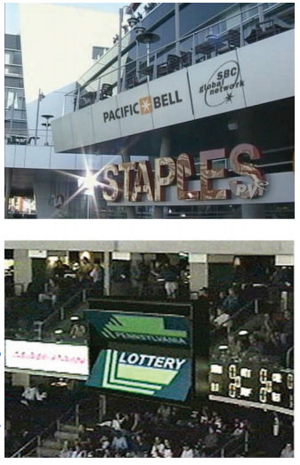
New Applications - Commercial
Football
Hockey
FoxTrax system
NASCAR
Advertisement

Slide 27
Overview
Enabling technologies
Interfaces and visualization
Visualization problems
New applications
Future work

Slide 28
Future Work
Few projects have gone past lab-based prototypes
Three obstacles
Technological
User interface
Social acceptance

Slide 29
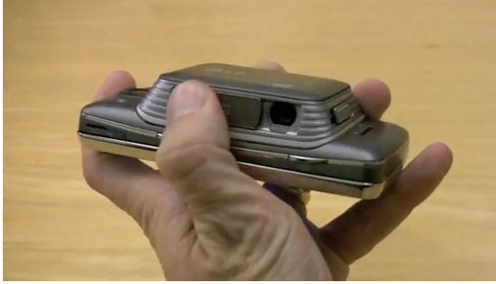
Future Work – Technological
Technology needs to be…
Lighter
Cheaper
Less power consuming
Computationally powerful
Accurate
Easy to use
Portable

Slide 30
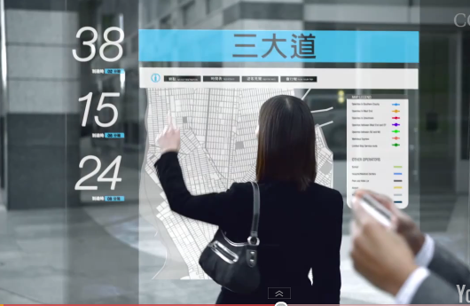
Future Work – User Interface
How do we…
Identify what data to provide
Present data in the most effective manner
Make user queries and reports effective

Slide 31
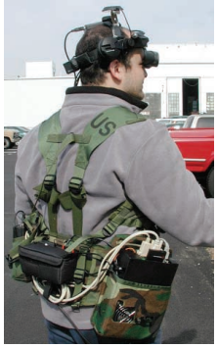
Future Work – Social Acceptance
How do we persuade a user to wear an AR system?
Issues include but not limited to…
Fashion
Privacy concerns

Slide 32
Q&A

